Slide 1
LENDING CLUB LOAN - EDA SUBMISSION
Name(s): RAMESH MUMMINENI & SHUBHAM VERMA

Slide 2


Problem Statement
Business Problem Objective ?
The objective of the business problem is to identify the patterns which indicate most likely defaulters of a loan to determine the creditloss.
Perform EDA to understand how consumer attributes and loan attributes influence the tendency of default.
Data Source : Lending Club’s historical data is provided for the analysis ,which comprises Demographic , Loan Characteristic and customer behavior variables are included in excel file. An exclusive data dictionary file is supplied in excel format to understand the variables.

Slide 3
Problem solving methodology
Used Python Programming Language and Jupyter notebook IDE.
Data has been analysed and carried out the Exploratory Data Analysis (EDA) for the given Lender’s club dataset to identify the drivers of defaulter’s.
To perform this, it is divided this into 4 categories.
Data Understanding | Data Cleaning & Data Manipulating | Data Analysis | Data Summary & Recommendations

Slide 4
PART-1 :Data Understanding
Importing the Python Libraries and Read the data to python data frame.
Check the data types for various columns and convert the data types.
Extract the numerical data from the required columns.
Total no.of columns/ variables are : 111
Total no.rows are : 39717
Identified the important independent variables and Target variable .
“Loan_Status” is considered to be critical in explaining the defaulters pattern and tendency.
Loan Status
Fully Paid
Charged Off
Current

Slide 5
PART 2:Data Cleaning & Data Manipulating
Checked the percent of the missing values across the variables
Removed all those with high missing percentage & unnecessary one’s.
Perform data cleaning steps for the remaining variables with less missing percentages - ‘dropping’ the high missing values in a row.
Drop all the rows for “current” loan from the loan_status variable.
Label the Fully Paid as ‘0’ and Charged Off as ‘1’.
The Strategy here is that to figure out the comparison of default rates across various explanatory variables and identify the ones that affect the default rate the most.
Target Variable: Default Rate
Loan Status
Fully Paid as ‘0’
Charged off as ‘1’

Slide 6
PART 3:Data Analysis
The objective is to identify predictors of Default so that at the time of loan application processing, lenders can use this info for approval/rejection of a loan.
We removed the customer behaviour variables from this analysis as they are actually not available at the time of loan application processing stage.
We considered only demographic variables and Loan Characteristics.
The Ones marked as ‘Current’ are neither Fully Paid nor Defaulted, so get rid out of the current loans.
UNIVARIATE
Analysis
Data Analysis
BIVARIATE
Analysis

Slide 7
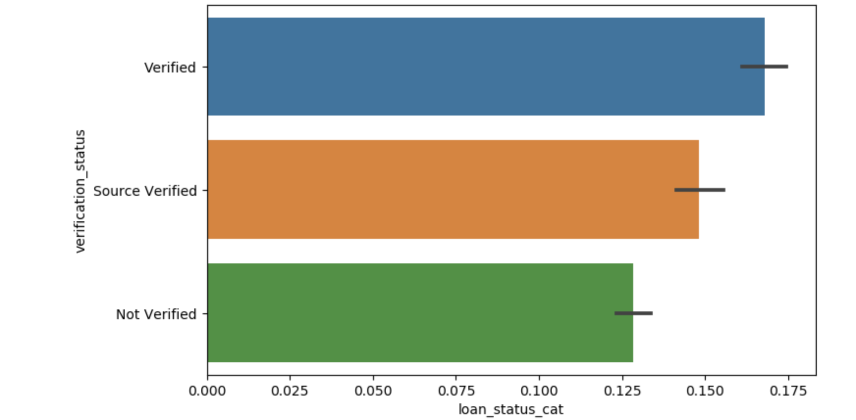
Univariate Data Analysis( UDA)
Checked the overall default rate for all the categorical variables and noted it as 15 %
Perform binning and completed the Univariate analysis on continuous variables such as loan amount and interest rate.
1. verification _status versus loan_status :
Insight :
Even though loans are approved after verification, it seems that default rate is higher than 'Non-verified' category, which is unexpected.

Slide 8
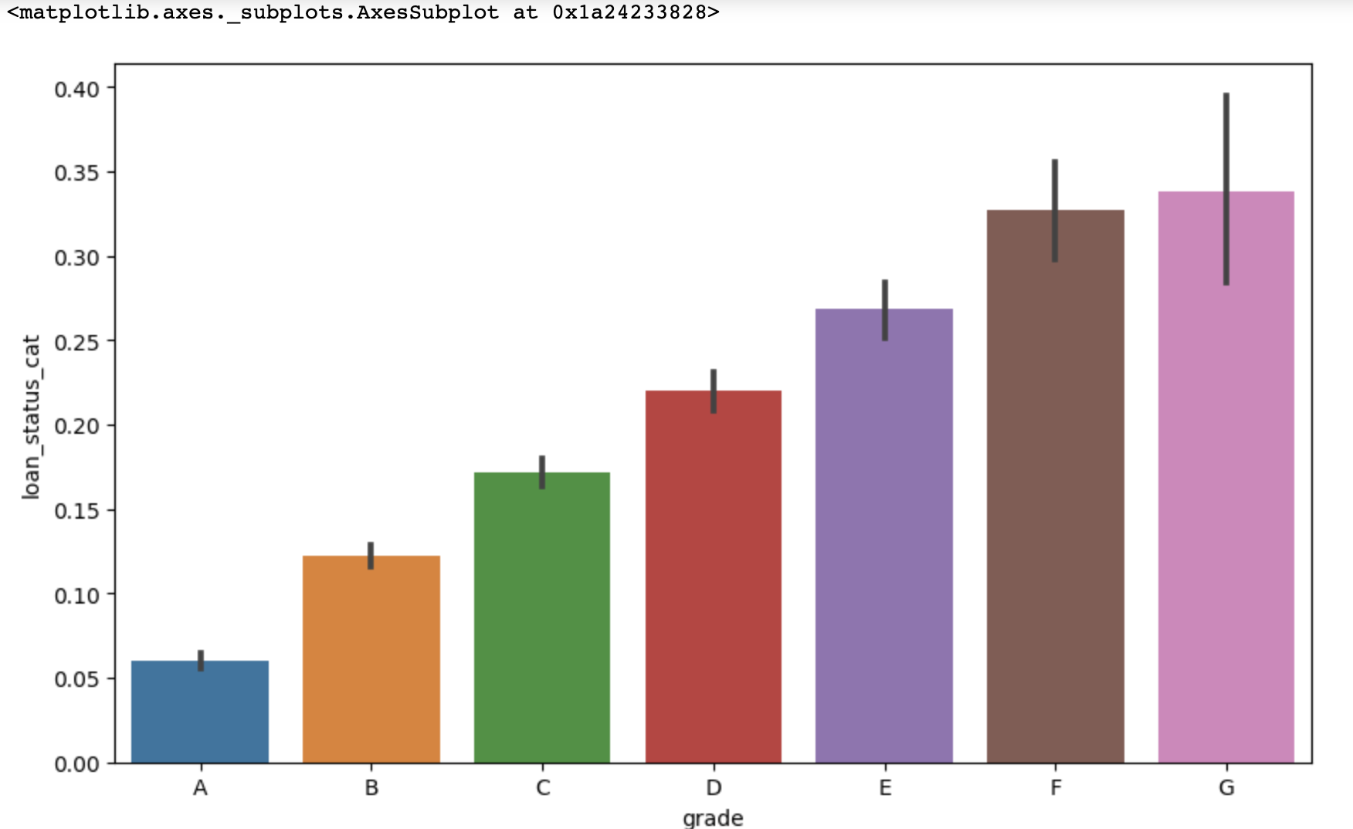
DATA VISUVALISATION : plot a graph bet GRADE & LOAN _STATUS
Key observation :
As the grade increases from A -> G, default rate is also increased, which is anticipated.

Slide 9
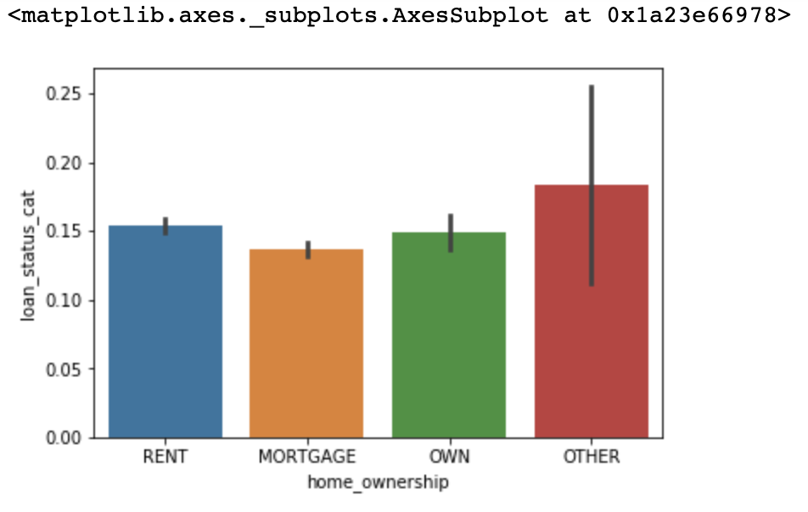
UDA : plot a graph bet Home_Ownership & LOAN _STATUS
The 'Other' category shows the highest number of defaulters in the given data followed by 'Rent' category.
We cannot determine that the borrower who is owning the home is less likely to default.

Slide 10
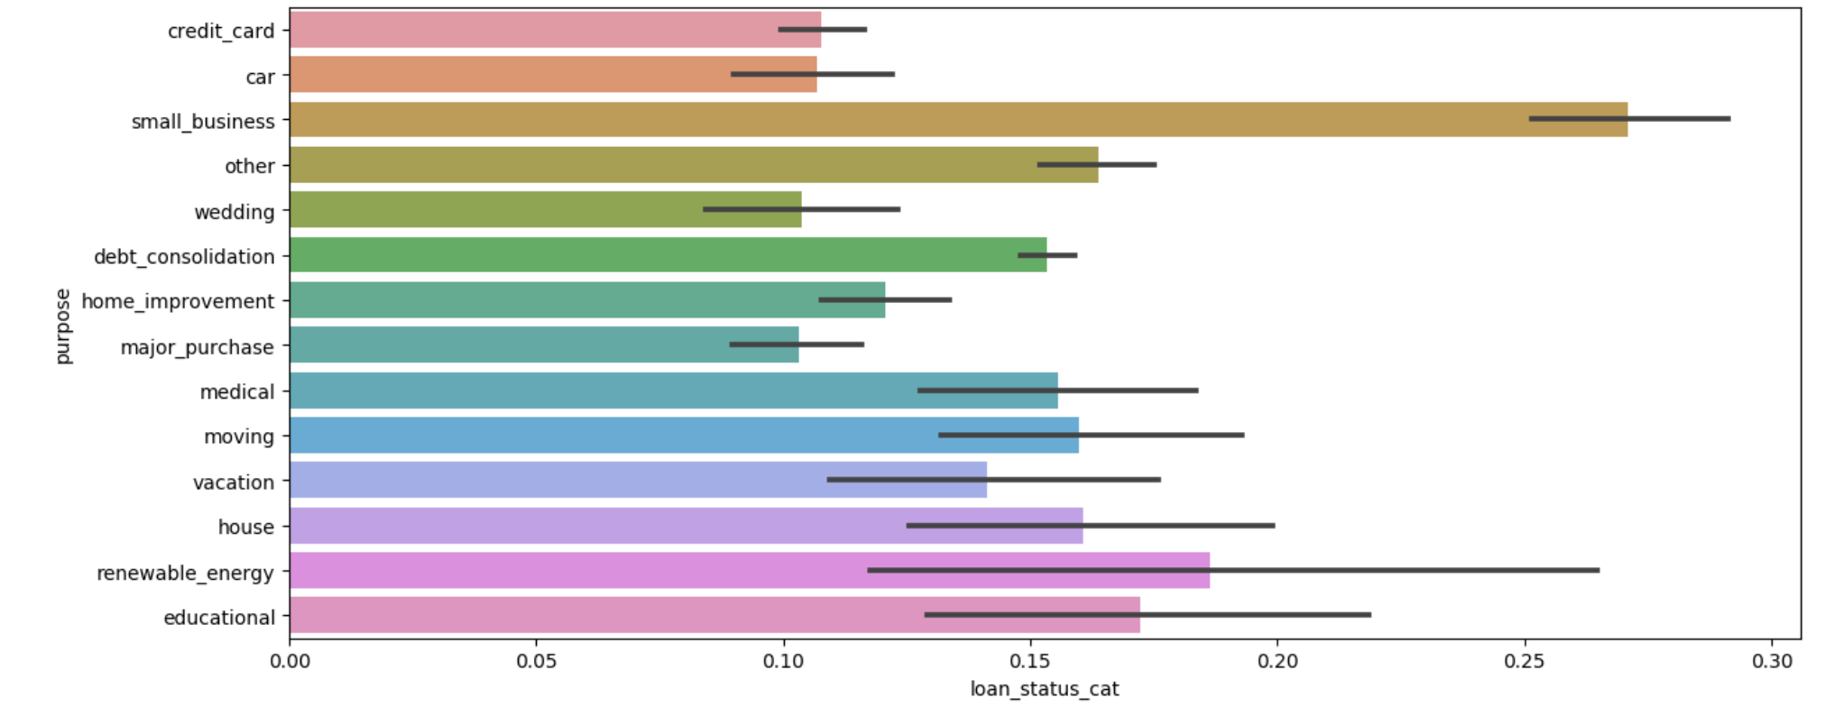
UDA : Loan Purpose vs Defaulter’s business type
Most of the borrowers who taken the loan for the purpose of "Small Business" followed by 'Renewable Energy’ are defaulters. It very significant.

Slide 11
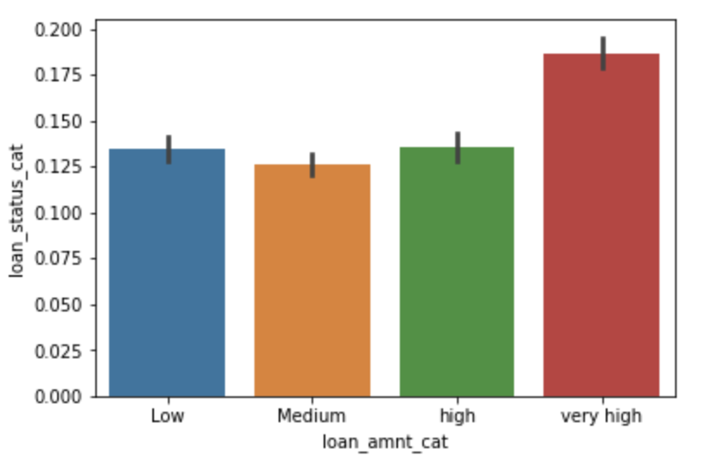
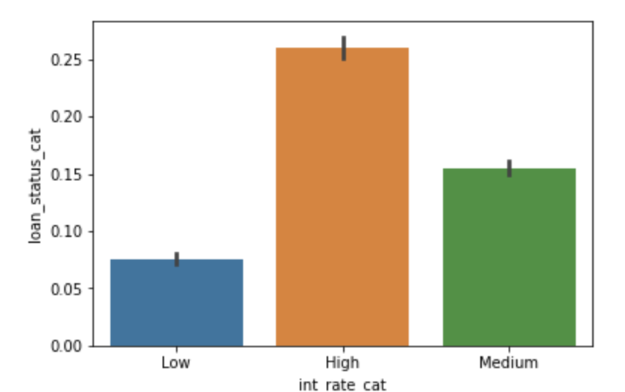
UDA:Plot Interest Rate & Loan Amount
Higher interest rate attracts higher Default rate.
Higher the Loan_amount, Higher the Default_rate.
* Read y –axis: loan_status_cat gives only default rates(coded as 1 )

Slide 12
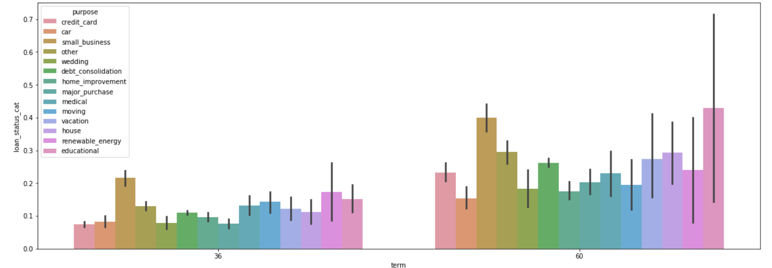
Bivariate Analysis:Comparing Loan Status vs Term, Purpose
'Educational' loans default rate are highest and 'Car' loans are lowest for 60 months term.
'Small business' loans have the next highest default rate in 60 months tenure.
For 36 months term, 'Small Business' loans have highest default rate and 'Credit Card' loans are the lowest.

Slide 13
PART-4:SUMMARY & RECOMMENDATIONS
SUMMARY :
1. In order to identify the patterns for the more likely defaulters from the lenders club data, we have carried out univariate analysis for checking the default rate across various categorical variables.
Further, we performed binning and completed univariate analysis for continuous variables as well.
2.To understand the behavior of the default variable, bivariate analysis has been done and identified the key insights.
3.Lastly, debt to income ratio analysis is carried out by classifying 'low', 'medium' and 'high' categories.
For all the analysis, separate plots has been derived.

Slide 14
RECOMMNEDATAIONS
To reduce this risk the following recommendations may follow by the lenders/Investors.
Higher interest rates on existing Loan impacting to Higher default rates. So, justification and caution is required..!
There is linear relationship between Loan amount and Default rate as former increases , later also increases. There is a perfect positive correlation is established. So, follow more data driven approach while approving highest loan amount..!!
Purpose of the loan approved is important. It is observed from the data that loans taken ‘Renuewble Energy’and ‘ Small Business’ are prone to default.
Term of the Loan is another driver for contributing the Default rate. So, more carefulness is advised while loan approval stage.

Slide 15
Thank you
Ramesh MUMMINENI
Thank You
Shubham VERMA

